Slide 1



Anytime
DeFi Teller AI
Simplifying Decentralized Finance with AI-Powered Insights

Slide 2

Problem Statement
DeFi platforms are complex and fragmented, making it hard for users to understand decentralized protocols, access crucial data, and make informed financial decisions, leading to poor adoption and suboptimal outcomes.

Slide 3


The Anytime DeFi Teller AI uses Large Language Models to provide real-time insights into Cardano DeFi, simplifying complex data from various protocols into easy-to-understand visuals and narratives. It empowers users of all levels to make informed decisions on staking, yield farming, and liquidity pools, making DeFi more accessible and user-friendly.

Slide 4

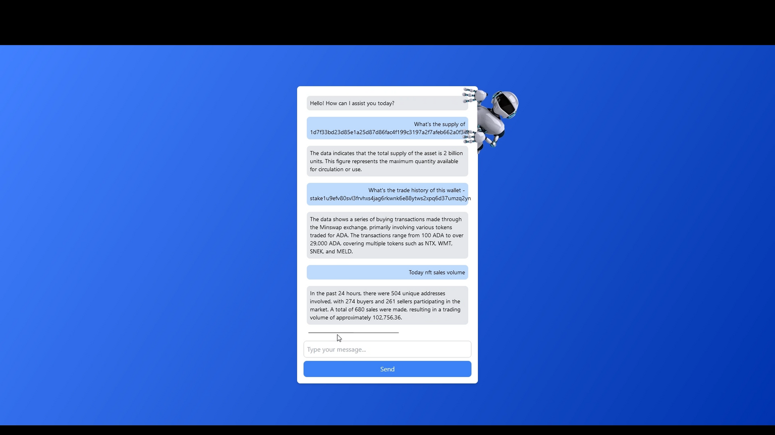
Demo Screenshot

Slide 5

Tech
Stack
Next.js
Frontend Framework
Taptools API
Comprehensive and real-time DeFi data
OpenAI
AI Integration leveraging advanced Large Language Models to provide insightful analytics

Slide 6
Thankyou
@a-r-u-t-h-r-a

